Slide 1


Slide 2
Assembler

Slide 3
Zoned and Packed Decimal Number

Slide 4
Topics to be Covered
Zoned and Packed Decimal Number
Decimal Instructions

Slide 5
Zoned Decimal Numbers
Takes one byte in storage
Similar to Character, but used to store numbers ‘0’ to ‘9’
Zoned Decimal are numbers which are defined for the ease of display.
+123 = ‘F1F2C3’, -123 = ‘F1F2D3’. ‘C’ for positive and ‘D’ for negative
Code is ‘Z’ e.g. Z’123’ , Z’-123’.
The last byte contains the number's sign as well as the last digit
Nibble - specifies 1/2 of a byte.
F|1 – 1111|0001 -> Zone bits and numeric bits.
F | 1 | F | 2 | C | 3

Slide 6
Packed Decimal Numbers
Packed Decimal Number – 2 Decimal digits in 1 byte
16 byte long
Packed – max 31 digits
Packed Decimal-Numbers which are defined for the ease of calculation.
+123 = ‘123C’, -123 = ‘123D’
Code is ‘P’. e.g. P’123’, P’-123’
+1234 in PACKED decimal it will be stored as 01 23 4C
-1234 in PACKED decimal it will be stored as 01 23 4D
In both packed and zoned number:
Positive – x’A’, x’C’, x’E’, x’F’
Negative – x’B’, x’D’

Slide 7
Zoned / Packed Decimal Numbers
Why we need this ??
INPUT(Zoned format) -> PACK -> Convert To Binary and save it in the system.

Slide 8
Pack
Converts Decimal numbers from a zoned form into a packed form.
L2 Bytes of the second operand are converted to a packed-decimal format without validating it.
Right justified result replaces the L1 bytes of the first operand.
If L1 > L2, then the result is padded on the left with binary zeros. If L1 < L2, truncation occurs.
PACK D1(L1,B1),D2(L2,B2)
Format – SS
Condition Code – Not Changed
Exceptions – Access - Fetch 2nd, Store 1st

Slide 9
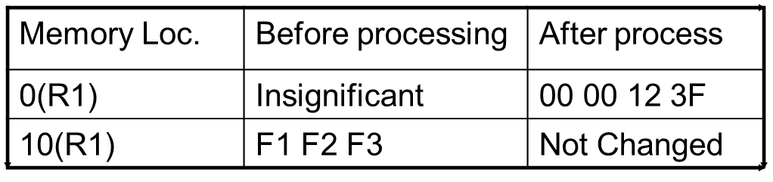
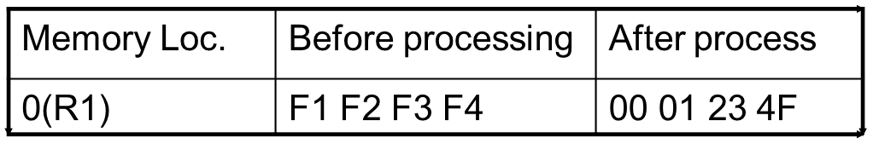
Pack
Eg., PACK 0(4,R1),10(3,R1)
Op code – F2 32 10 00 10 0A
Eg., PACK 0(4,R1),0(4,R1)
Op code – F2 33 10 00 10 00

Slide 10
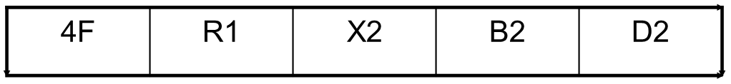
Convert to Binary
Converts the packed decimal number in the 8 byte field (in double word boundary) to an integer in the 2’s complement binary number system.
Instruction checks both the sign code and the digit code of the packed decimal number for validity.
CVB R1,D2(X2,B2)
Format – RX
Condition Code – Not Changed
Exceptions – Data Exception, Fixed point Divide, Access – Fetch 2nd operand

Slide 11
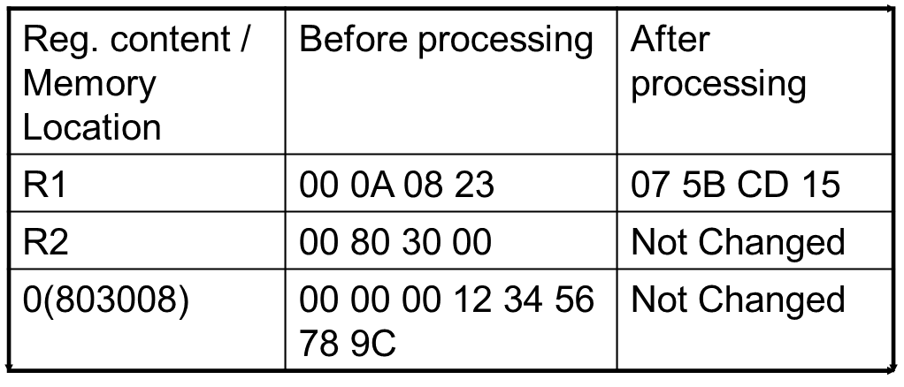
Convert to Binary
Eg., CVB R1,8(R2)
Op code – 4F 10 20 08

Slide 12
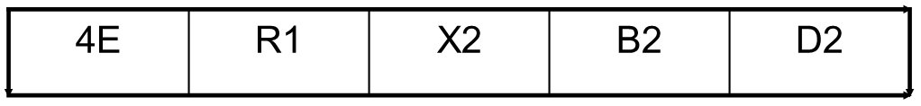
Convert to Decimal
Converts a 32 bit signed binary integer in the Register R1 to an 8 byte packed-decimal number at the second operand location.
Pads the left of the result with zeros.
CVD R1,D2(X2,B2)
Format – RX
Condition Code – Not Changed
Exceptions – Access – Store 2nd operand,

Slide 13
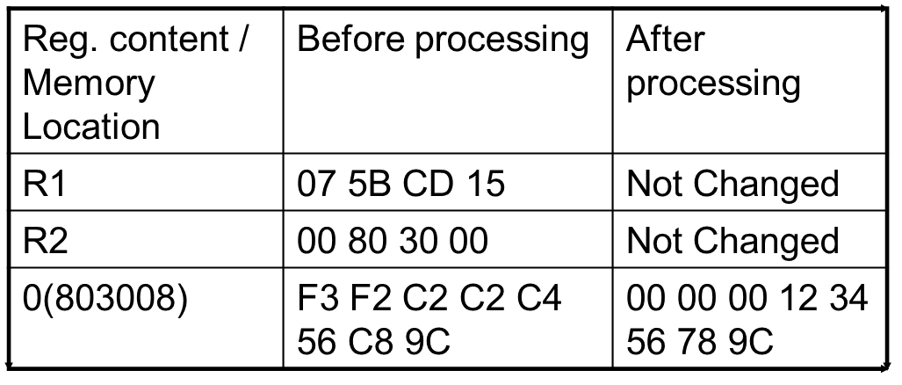
Convert to Decimal
Eg., CVD R1,8(R2)
Op code – 4E 12 00 08

Slide 14
UnPack
Converts Decimal numbers from a packed form into a zoned form.
L2 Bytes of the second operand are converted to a zoned-decimal format without validating it.
Right justified result replaces the L1 bytes of the first operand.
If L1 > L2, then the result is padded on the left with EBCDIC zeros. If L1 < L2, truncation occurs.
UNPK D1(L1,B1),D2(L2,B2)
Format – SS
Condition Code – Not Changed
Exceptions – Access - Fetch 2nd, Store 1st

Slide 15
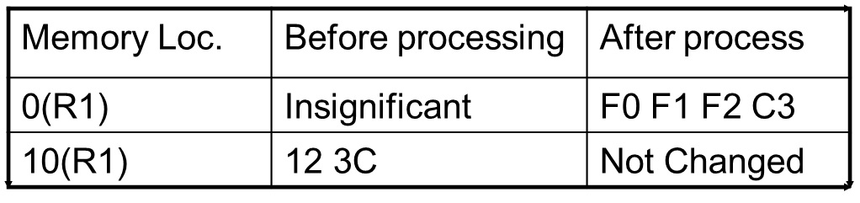
UnPack
Eg., UNPK 0(4,R1),10(2,R1)
Op code – F3 31 10 00 10 0A
Eg., UNPK 0(3,R1),0(3,R1)
Op code – F3 22 10 00 10 00
Memory Loc. | Before processing | After process
0(R1) | 12 34 5C | F3 F4 C5

Slide 16
Add Packed
Adds 2 packed-decimal numbers and the result is stored in the first operand in packed form. Length of the operands are to be explicitly specified. Length in the instruction code are less by 1 than the actual length.
AP D1(L1,B1),D2(L2,B2)
Format – SS
Condition Code –
0 = Sum 0
1 = Sum –ve
2 = Sum +ve
3 = Overflow
Exceptions – Access – Fetch 2nd operand, Store 1st Operand, Decimal overflow, Data Exception.

Slide 17
Add Packed
Eg., AP 0(4,R1),0(2,R2)
Op code – FA 31 10 00 20 00
Reg. content / Memory Location | Before processing | After processing
0(R1) | 00 01 23 4C | 00 01 32 0C
0(R2) | 08 6C 00 00 | Not Changed

Slide 18
Subtract Packed
Subtracts 2 packed-decimal numbers and the result is stored in the first operand in packed form. Computes the difference by changing the sign of a copy of the second operand and add it to the first operand.
SP D1(L1,B1),D2(L2,B2)
Format – SS
Condition Code –
0 = Sum 0
1 = Sum –ve
2 = Sum +ve
3 = Overflow
Exceptions – Access – Fetch 2nd operand, Store 1st Operand, Decimal overflow, Data Exception.

Slide 19
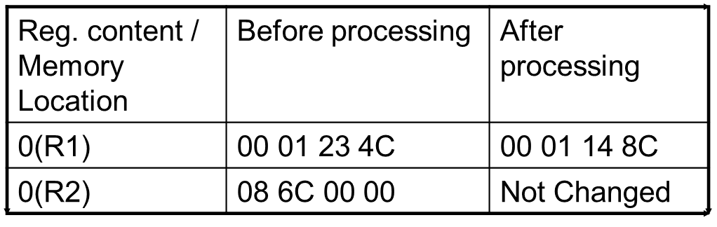
Subtract Packed
Eg., SP 0(4,R1),0(2,R2)
Op code – FB 31 10 00 20 00

Slide 20
Multiply Packed
Computes the product of 2 packed-decimal numbers. Product replaces the multiplicand.
If the leading zeros are ignored, the no. of digits in a decimal integer product cannot exceed the sum of the number of digits in the operands. To ensure that the product will fit into the L1 bytes of the first operand,
L2 <= 8 and L2 < L1 and L1 <=16
L1 must contain at least L2 bytes of leading zeros.
MP D1(L1,B1),D2(L2,B2)
Format – SS
Condition Code – Not Changed
Exceptions – Access – Fetch 2nd operand, Store 1st Operand, Specification, Data Exception.

Slide 21
Multiply Packed
Eg., MP 0(4,R1),0(2,R2)
Op code – FC 31 10 00 20 00
Reg. content / Memory Location | Before processing | After processing
0(R1) | 00 01 23 4C | 01 06 12 4C
0(R2) | 08 6C 00 00 | Not Changed

Slide 22
Divide Packed
Computes the division of 2 packed-decimal numbers. Quotient and Remainder replaces the dividend.
Always both quotient and remainder exists. Remainder – L2 bytes and Quotient – (L1-L2) bytes.
Sign of the quotient = those of the operands; Sign of the remainder = sign of the dividend.
L2 <= 8 and L2 < L1
Left most digit of the first operand must be zero.
DP D1(L1,B1),D2(L2,B2)
Format – SS
Condition Code – Not Changed
Exceptions – Access – Fetch 2nd operand, Store 1st Operand, Specification, Decimal Divide, Data Exception.

Slide 23
Divide Packed
Eg., DP 0(4,R1),0(2,R2)
Op code – FD 31 10 00 20 00
Reg. content / Memory Location | Before processing | After processing
0(R1) | 00 01 23 4C | 01 4C 03 0C
0(R2) | 08 6C 00 00 | Not Changed

Slide 24
Compare Packed
Compare 2 packed-decimal numbers and set condition code accordingly.
CP D1(L1,B1),D2(L2,B2)
Format – SS
Condition Code –
0 – Operands Equal
1 – First operand low
2 – First operand High
Exceptions – Access – Fetch 1st and 2nd Operand, Data Exception.

Slide 25
Compare Packed
Eg., CP 0(4,R1),0(2,R2)
Op code – F9 31 10 00 20 00
Condition Code - 2
Reg. content / Memory Location | Before processing | After processing
0(R1) | 00 01 23 4C | Not Changed
0(R2) | 08 6C 00 00 | Not Changed

Slide 26
Zero and Add Packed
Replaces the content of the first operand field with a copy of the packed-decimal number in the second operand field, which is adjusted appropriately to match the length o L1 of the first field, after necessary truncation or left padding with zeros.
ZAP D1(L1,B1),D2(L2,B2)
Format – SS
Condition Code –
0 – Result is zero
1 – Result is negative
2 – Result is positive
3 – Overflow
Exceptions – Access – Fetch 2nd Operand, Store 1st Operand, Decimal overflow and Data Exception.

Slide 27
Zero and Add Packed
Eg., ZAP 0(4,R1),0(2,R2)
Op code – F8 31 10 00 20 00
Condition Code - 2
Reg. content / Memory Location | Before processing | After processing
0(R1) | 00 01 23 4C | 00 00 08 6C
0(R2) | 08 6C 00 00 | Not Changed

Slide 28
Shift and Round Packed
Shifts the packed-decimal at the first operand location value specified at the rightmost 6 bits of the second operand which is in 2’s complement binary number system.
A positive value represents a left shift whereas a negative value represents a right shift.
To round before a shift, the third operand is added to the leftmost of the digits which are shifted out and the carry is propagated. The value is then shifted right.
SRP D1(L1,B1),D2(B2),I3
Format – SS
Condition Code – 0 – Result is zero; 1 – Result is negative;
2 – Result is positive; 3 – Overflow
Exceptions – Access – Fetch and Store 1st Operand, Decimal overflow and Data Exception.

Slide 29
Shift and Round Packed
Eg., SRP 0(4,R1),B’111110’,6
Op code – F0 36 10 00 00 3E
Condition Code - 2
Reg. content / Memory Location | Before processing | After processing
0(R1) | 01 23 45 6C | 00 01 23 5C

Slide 30
Questions!!?

